Slide 1
Posture Watcher Milestone Presentation
By Phil Johnson, Gerald Killiany, Evan Kutney, and Sean McHale

Slide 2
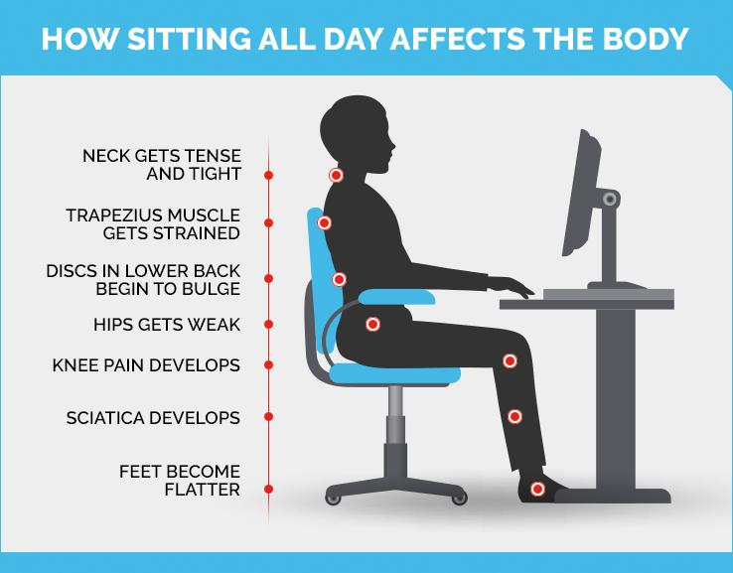
The Problem
People sit too much
Especially post- pandemic
Many Health issues
Source: New York Presbyterian

Slide 3
The Posture Watcher
Goal - encourage healthy sitting habits
Provide Reminders
When phone connected:
Reminders through notifications
Data tracked & displayed in app
Change settings in app:
Time for seated notification
Frequency of posture notifications

Slide 4
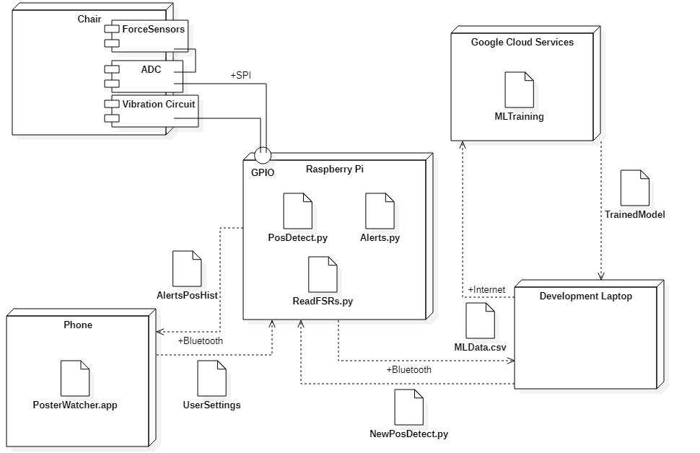
System Architecture

Slide 5
Team Member 1
Phil Johnson

Slide 6
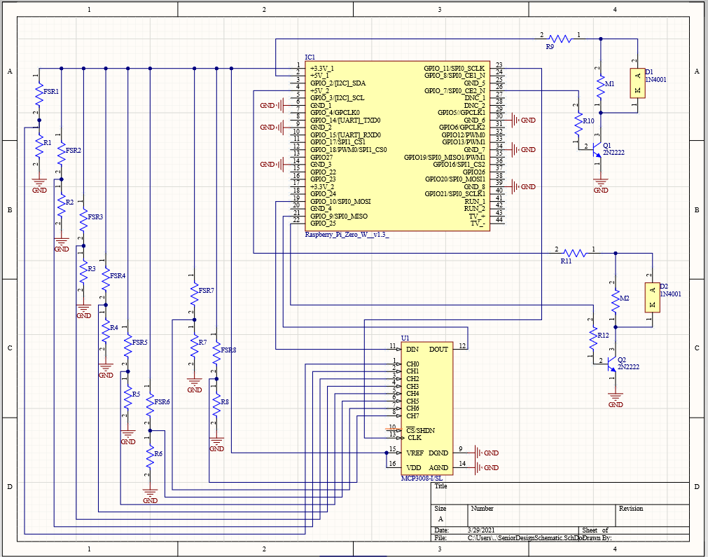
Responsibilities
Hardware Design and Testing (Complete)
PCB layout and Routing (Completed this week)
Enclosure Design and Prototyping (Completed within next week)
Admin
Figure: Final PCB Schematic

Slide 7
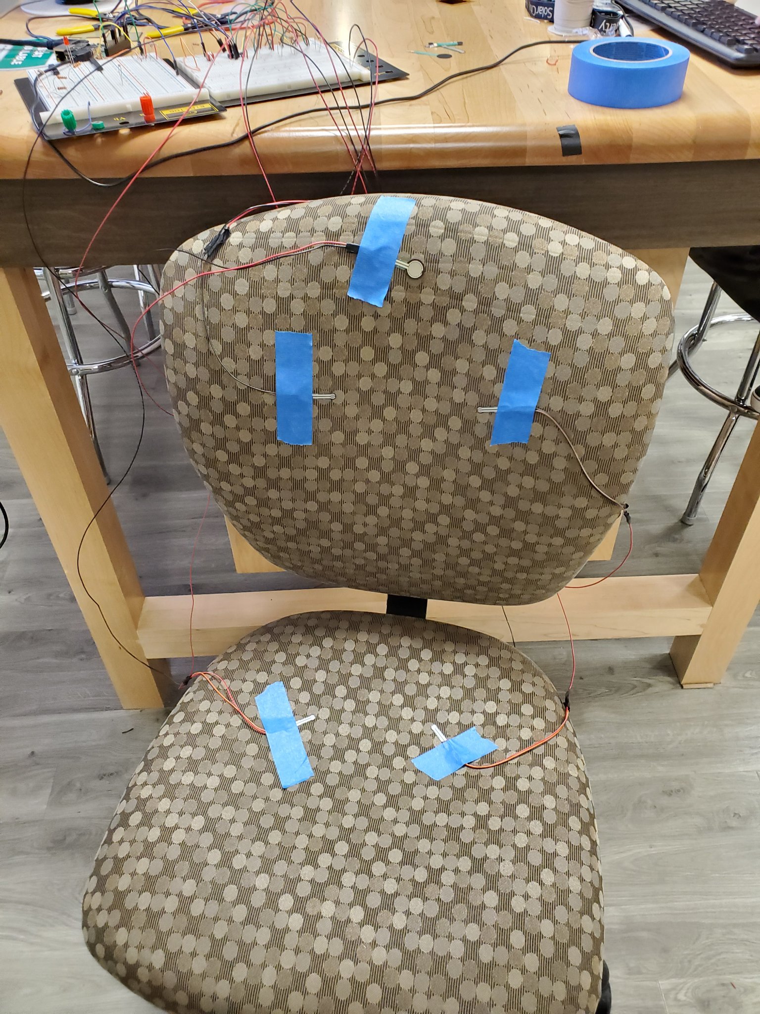
Hardware Design
8 Force Sensitive Resistors in voltage dividers feeding into ADC
Vibration motors powered by Pi to run chair off of singular power source
Runs off of rechargeable USB-C Powerbank for over 16 hours
FSRs ran off of wires attached to chair
Figure: Prototype of Final Design with “borrowed” chair

Slide 8
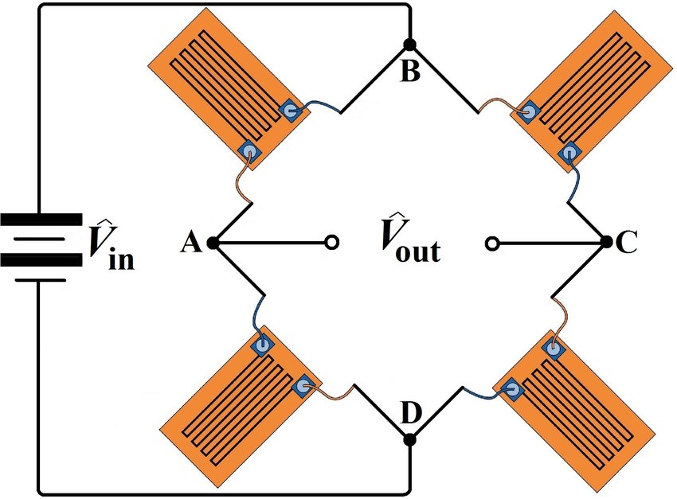
Hardware Testing
Initial design involved strain gauge Wheatstone Bridge
ADC switched from HX711 to MCP3008
FSR sensitivity can be tuned with secondary resistor value
https://www.researchgate.net/figure/A-full-Wheatstone-bridge-strain-gauge-circuit_fig9_325339654

Slide 9
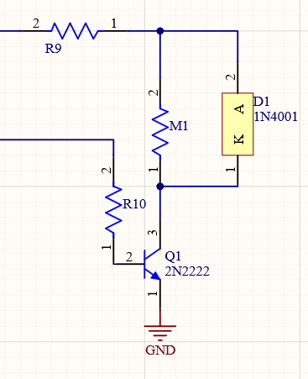
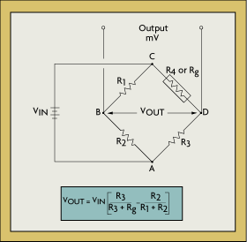
Motor Circuit
Requires 120 mA starting current per motor
Amplification needed to achieve desired current from Pi Zero pins
Two motors to be attached to bottom cushion
Successfully tested
Figure: Motor Schematic in Altium

Slide 10
Budgeting
Budget should remain under allotted 200$
Anticipated Costs
Team Chair for final build
Possibly Additional FSRs
Team has used available resources to remain within budget constraints
Vendor | Purpose | Order Cost | Total Budget Remaining
 | Initial Budget | 0 | 200
Amazon | Strain Gauges/ADC | 17.98 | 182.02
Adafruit | Microcontroller + Components | 45.45 | 136.57
Interlink | FSRs | 27.95 | 108.62
Digikey | Parts/Motors | 20.83 | 87.79

Slide 11
Team member 2
Gerald Kiliany

Slide 12
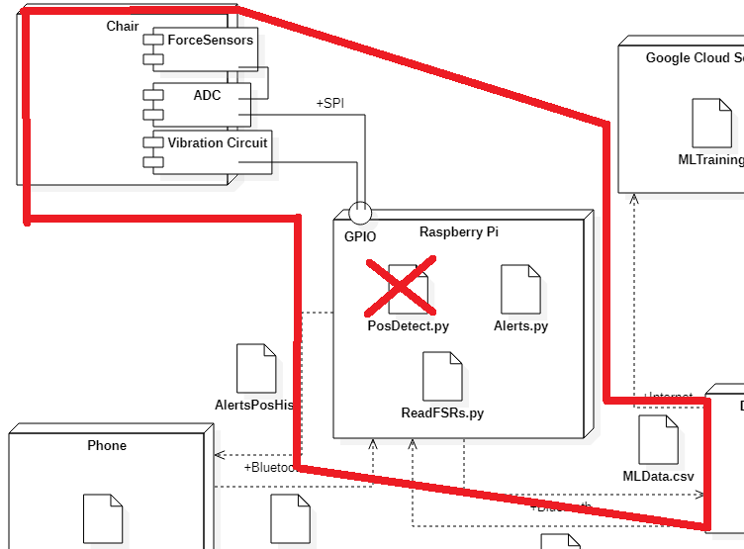
Progress so far
Read inputs, detect seating, timing for alerts (choices 1 & 2)
Add vibration mode
Prototype breadboard
Write data to CSV
Document Sys Arch

Slide 13
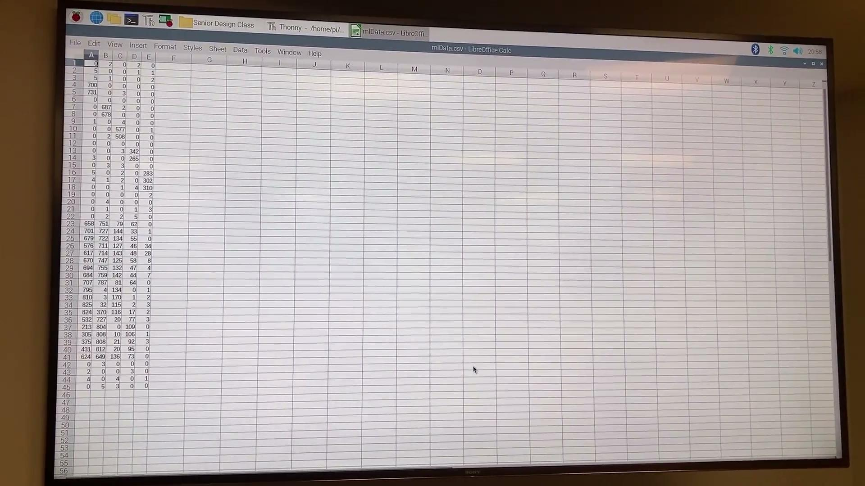

Slide 14
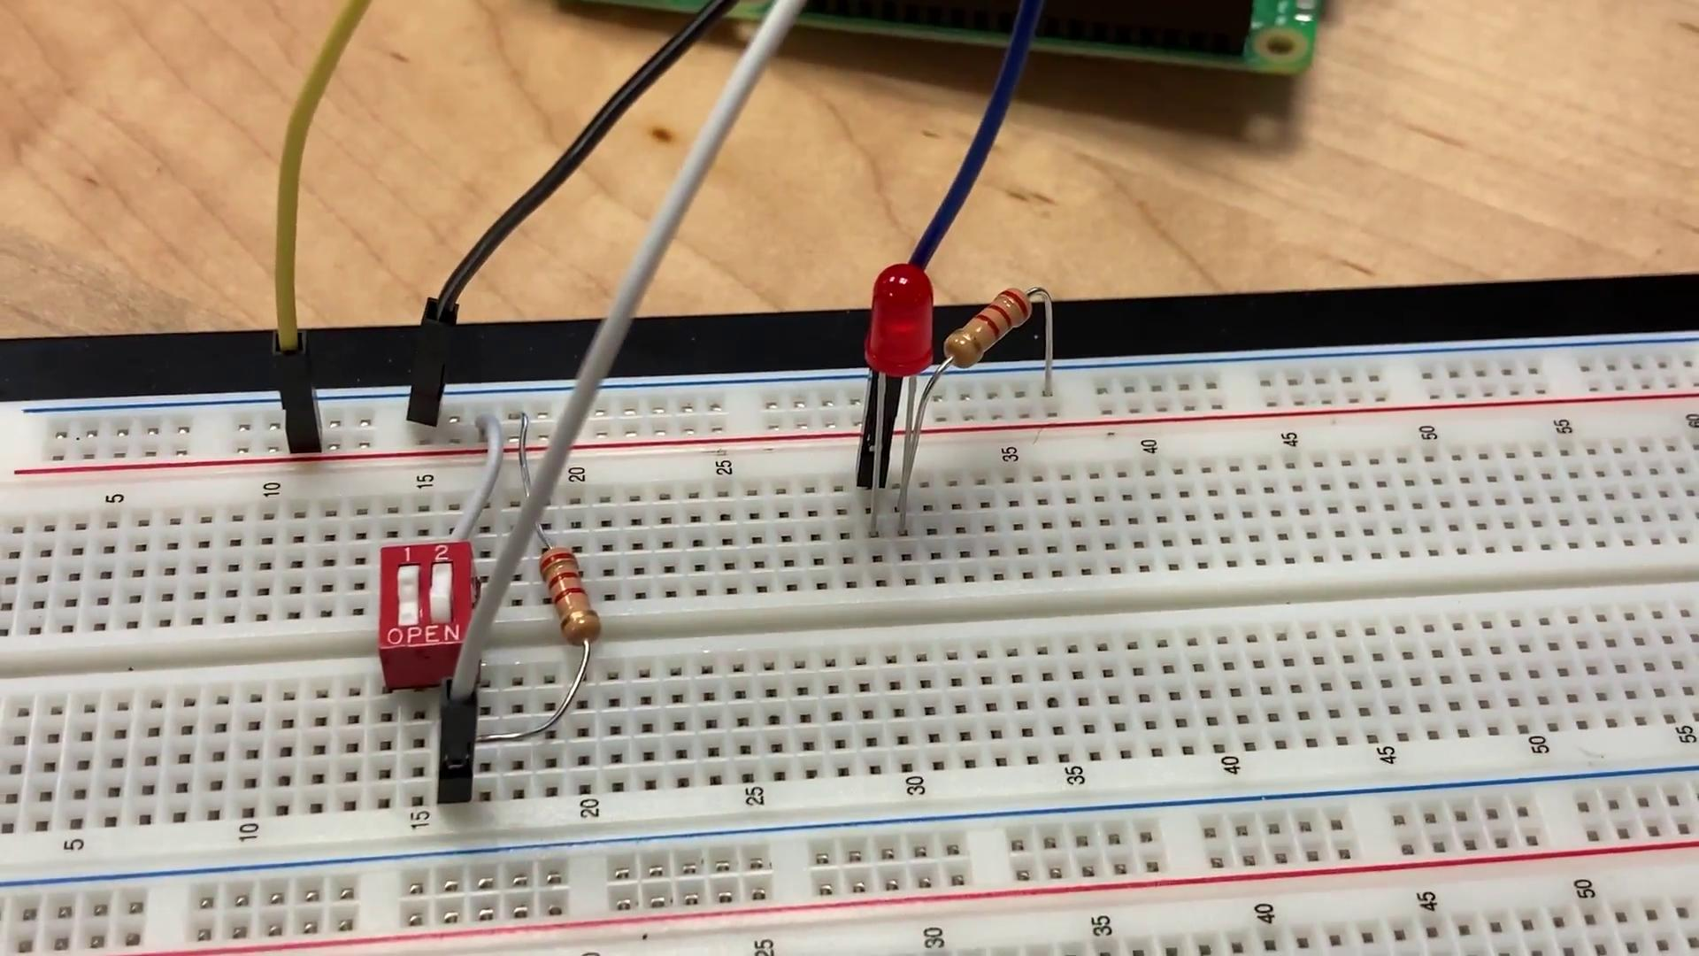
Add vibration mode functionality

Slide 15
Next Goals
Send seating history & alerts to phone
Read user settings from phone

Slide 16
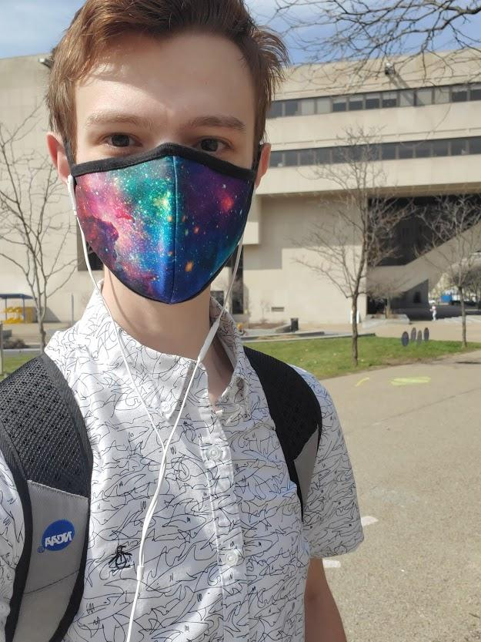
Team member 3
Sean McHale

Slide 17
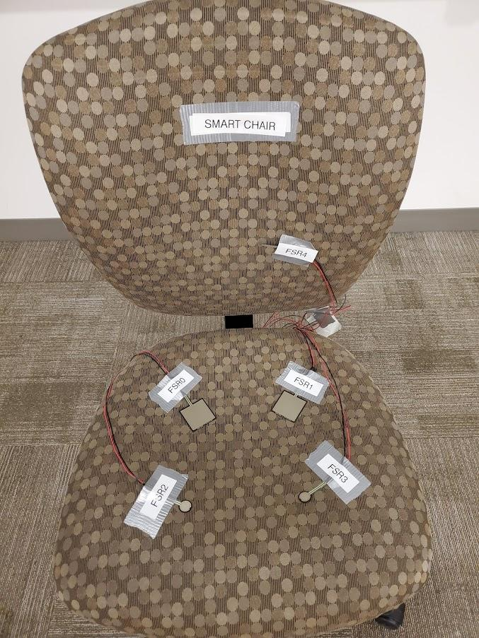
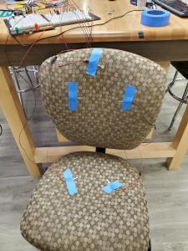
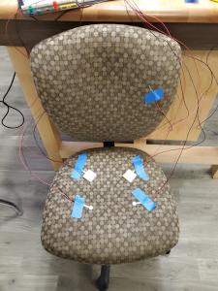
Assisted Sensor Construction and Iterated Placement

Slide 18
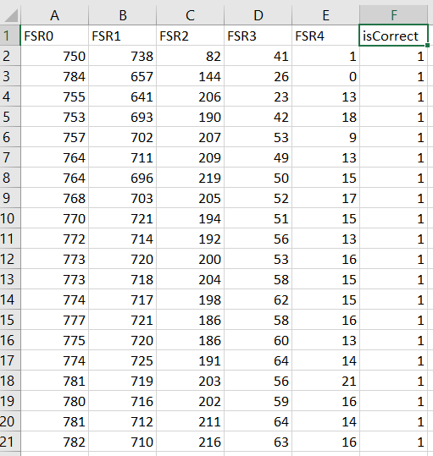
Trained New Model with actual Chair data
Gathered 6000 data points, 3000 with good posture and 3000 with bad
Each data point consisting of 5 sensor inputs and a classification label

Slide 19
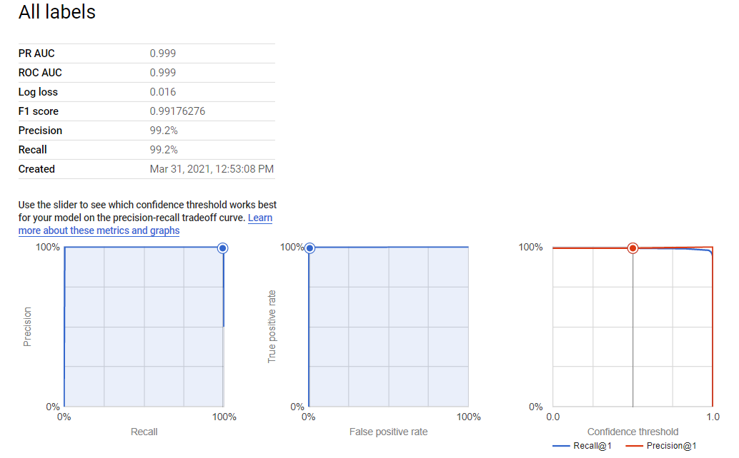
Got some surprisingly good results
99.2% Precision!
This is unrealistically high
Possible Explanations:
Only one person collected the data
Different types of sensors may have complicated matters
Possible that bad data may be over exaggerated

Slide 20
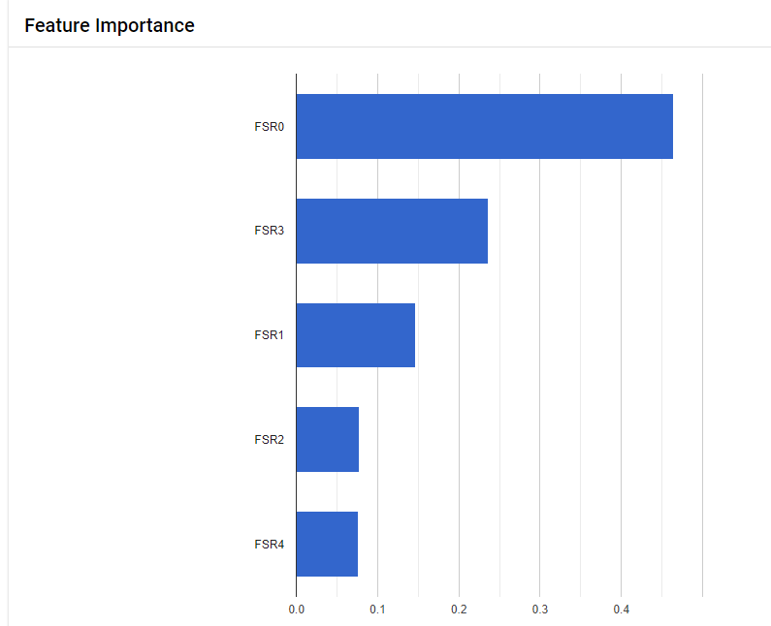
Interesting Results
FSR0

Slide 21
Goals Moving Forward
Conduct a more thorough model training using multiple individuals
Continue to iterate on sensor placement using smaller models and examining weights
Export the model as a TensorFlow model to the pi, and try to get real time classification running on the pi

Slide 22
Team member 4
Evan Kutney

Slide 23
Choose between BLE or Serial connection over Bluetooth
BLE pros
Save battery life
Communicate with ios or android
BLE cons
Time to pass data

Slide 24
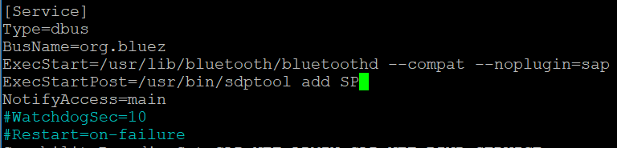

Setting up serial connection
Add flags/line to dbus-org.bluez.service
Reload daemon
Restart bluetooth

Slide 25
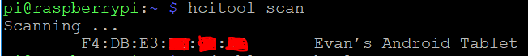


Setting up serial connection
Scan for android device
Pair devices
Trust android device

Slide 26
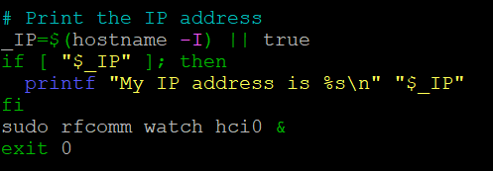
Setting up serial connection on startup
Edit rc.local file to have pi search for connection upon startup

Slide 27
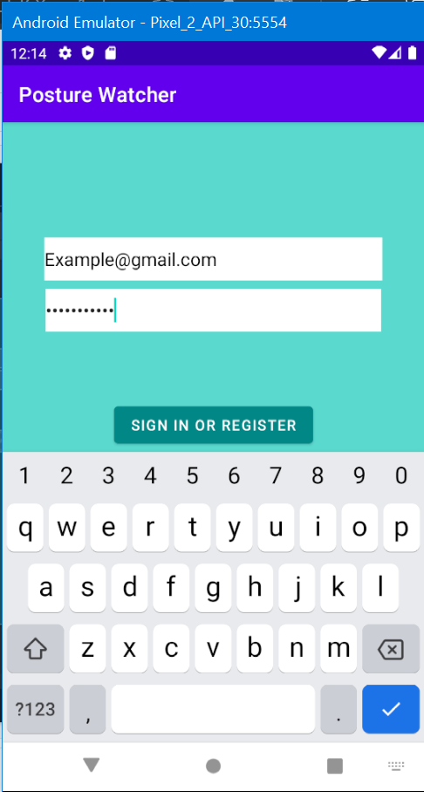
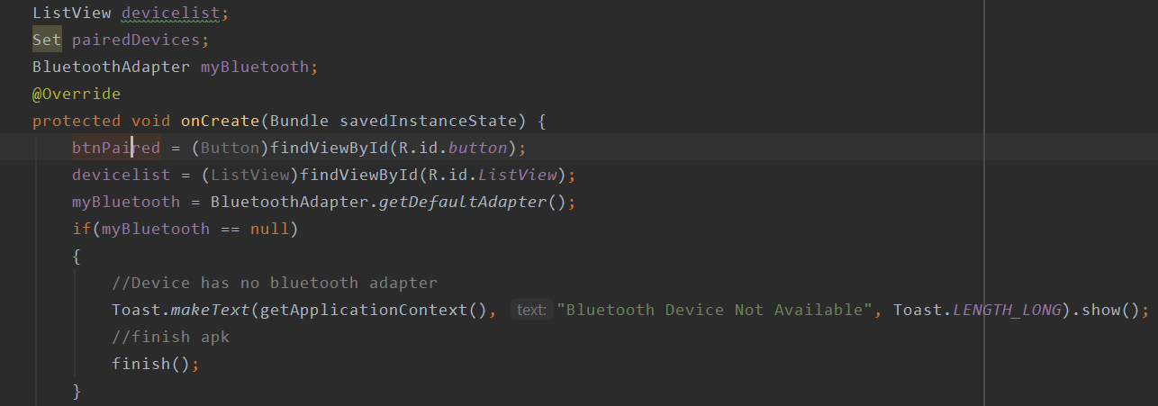
On the Android side
Download Serial Bluetooth Terminal
Enables communication back and forth
Needed for various cases
Direct communication through app
In progress

Slide 28
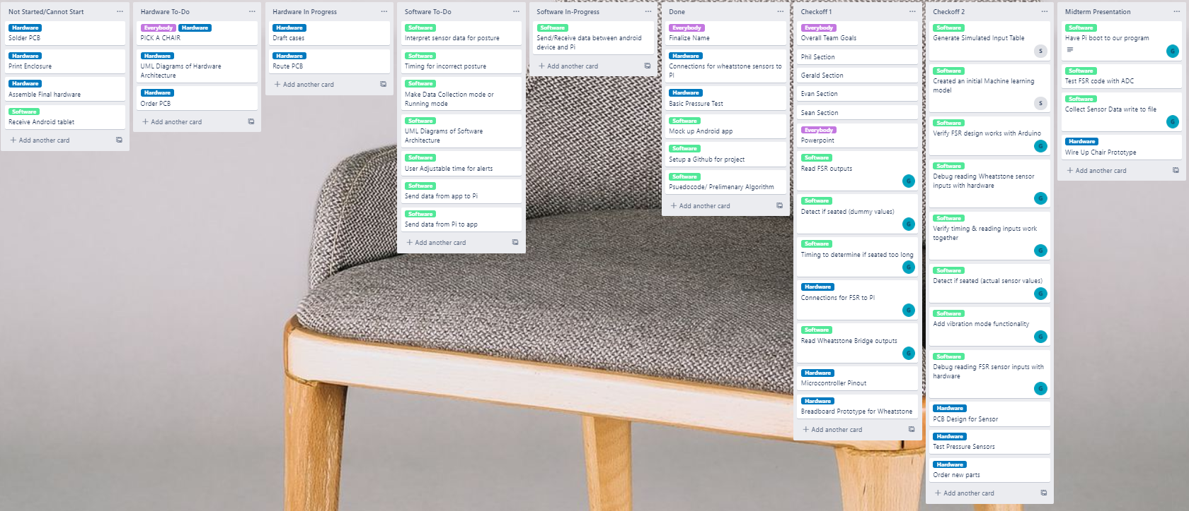
Trello Board

Slide 29
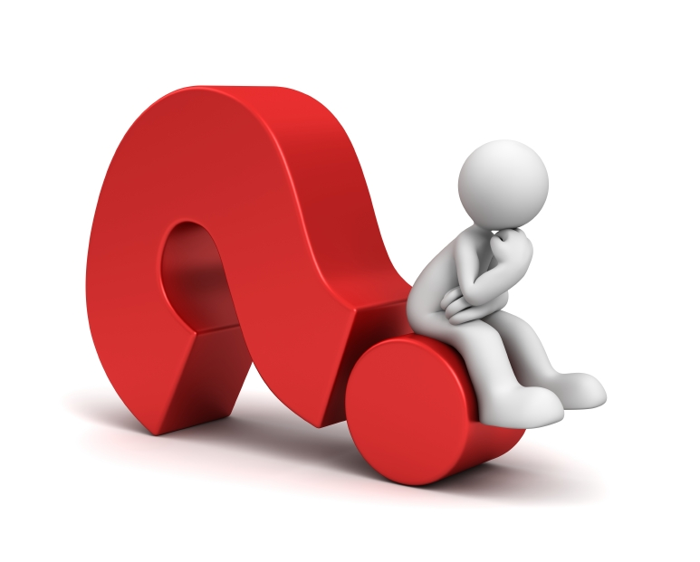
Questions?

